Slide 1

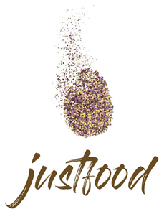

Building on trust: contesting the exclusionary effects of organic certification through community-supported agriculture
HESTIA I. DELIBAS
Centre for Social Science - University of Coimbra
Phd Student - Democracy in the XXI century
"This work was financed by FEDER - European Fund for Regional Development funds through the COMPETE 2020 - Operational Programme for Competitiveness and Internationalisation (POCI), and by Portuguese funds through FCT - Foundation for Science and Technology in the framework of the project 029355. Reference: POCI-01-0145-FEDER-029355"

Slide 2

Organic certifications
Organic
The “quality turn” - the growing concern for food safety and environmental issues, has lead to a rise in demands for products that meet social and environmental concerns
If certificates were meant to offer more transparency to the consumer and build trust, they were slowly co-opted into corporate practice, which transformed them into another marketing tool.
Goodman, D. (2003). The quality turn and alternative food practices: reflections and agenda. Journal of Rural Studies, 1(19), 1-7

Slide 3
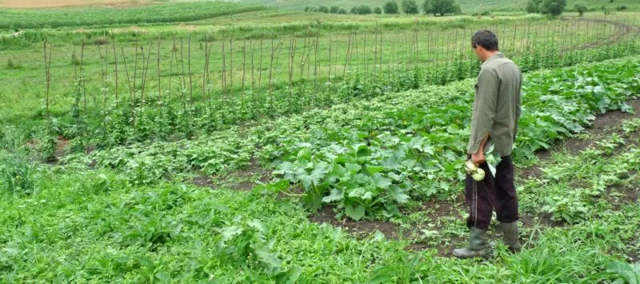
Alternative Food Networks, especially direct selling networks like CSA (community-supported agriculture) are meant to address these issues by re-introducing social relations into the food system
AFNs are characterised by the relationship between consumer and producer that extends beyond an instrumental purpose so that participation in this type of exchange has an intrinsic symbolic value for both parties beyond market logic.
The re-spatialisation of production and distribution and the establishment of a relationship based on solidarity, are the premises of these various types of exchanges

Slide 4
Research methods
Research question:
How is "alternative agriculture" understood by producers and consumers of a short food supply chain from Romania?
Methodology: qualitative data analysis
Data sources:
-15 interviews (initiator, consumers, producers)
- Social media content analysis

Slide 5

Peasant Box (Cutia Țăranului)
Peasant Box (Cutia Țăranului), which works based on a direct subscription to a near-city farm, which periodically prepares and delivers a box of various seasonal foods obtained in the household.
The subscription is a long-term one, excluding the the possibility of purchasing a box only once, precisely to encourage the formation of a relationship between consumer and producer.

Slide 6
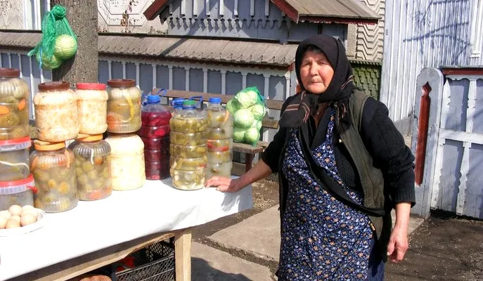
Discourse about “clean food”
The term “clean food" is used in place of organic or bio, which would only be possible based on a certification.
The two discursive constructions built around food, are based on:
the place of origin (authenticity)
on the way it is produced (naturalness)

Slide 7
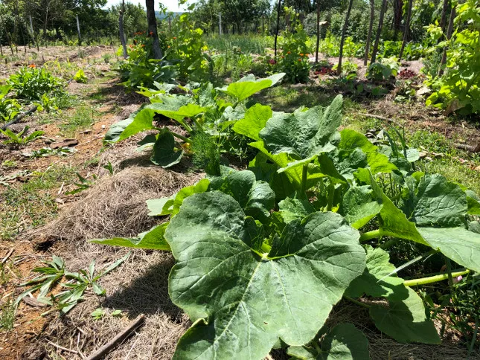
Trust is an essential element of the relationship between the participants of a CSA that is necessary for the function of this type of projects.
What sets apart the relationship through this network is the fact that it is kept informal

Slide 8
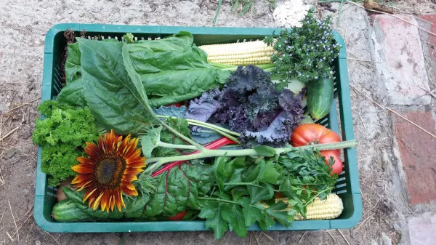
Conclusions
- short networks counteract the exclusionary effects of certificates by re-introducing close relationships based on the trust between consumers and producers
-in the absence of imposed definitions regarding quality, people create their own rhetoric about what defines food as good
Thank you!

