Slide 1
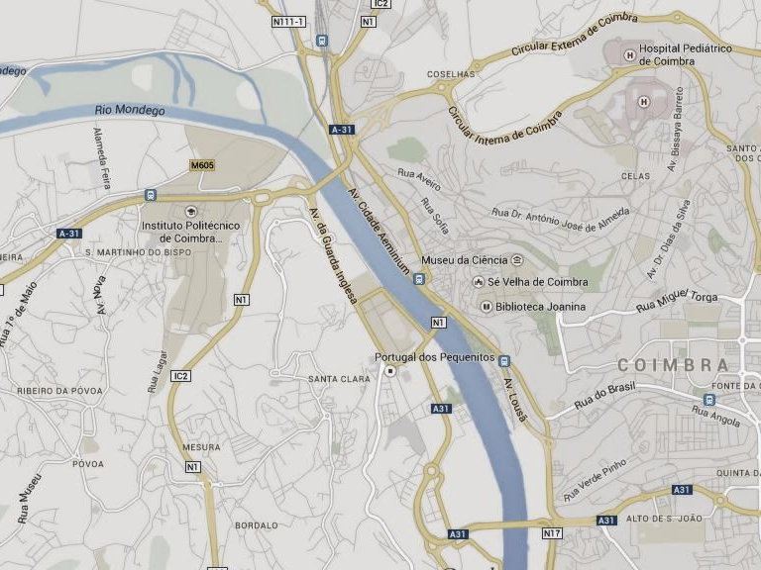


ARTERIA
Cláudia Pato Carvalho
9 de junho de 2017

Slide 2
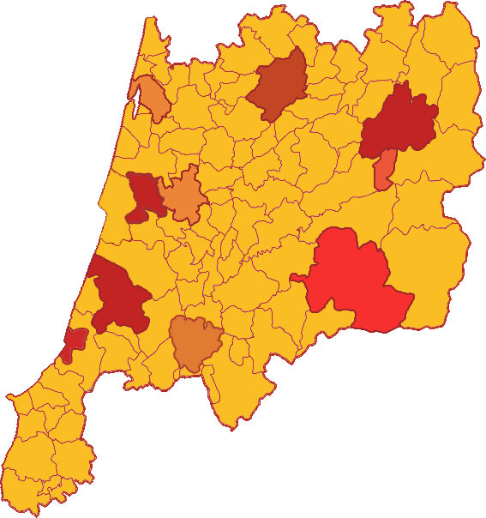
Territory:
Coimbra;
Figueira da Foz;
Ourém;
Nazaré;
Guarda;
Castelo Branco;
Belmonte;
Viseu

Slide 3
Problem – Starting Point
How can we articulate and, consequently, increase the contributions of local municipalities, academic institutions (researchers) and cultural agents (artistic creation) with the aim of contributing to the cultural planning and development of communities, combining both a practical and a theoretical dimension?

Slide 4
Mechanisms
Diagnostic Tools
Mapping Processes
Supporting
Projects of Artistic Intervention
Question Campaign
Other Activities
Complement
Regular arts education activities with the community
Cultural programming and artists in residence programs

Slide 5
Lack of articulation between cultural agents and other local institutions: articulation of agendas, circulation and visibility of projects, dynamization of various cultural spaces, promotion of joint artistic projects and sharing of resources, spaces and technical material;
Need to increased awareness the academic environment and the wider community on the cultural issue;
Lack of involvement and participation of citizens in cultural activity (although there has been an exponential growth of involvement in recent years) - low adherence to events and initiatives;
Desertification of the territory - isolation of territories - lack of integrated cultural view of the territories;
Insufficiency of information on patrimonial and cultural spaces to ensure the permanence of the visitor - need to highlight the 'small histories' of places and spaces (non-material focus)
Lack of knowledge of the city / territory (little identification of the communities with the territories
Effective cultural decentralization is barely visible - Lack of regional-level cultural planning
Deficit of cultural education of the families and for cultural opportunities and projects that motivate and mobilize (deficit in the relation between arts education and ciitizenship – artistic creation leaves little ballast)
Difficulty in touring artistic projects
Lack of professional qualification in the artistic field
Need for the cultural sector to be funded in a sustained way by the government
Update of the repertoires of the groups - artistic challenge of connecting innovation to tradition
Lack of renewal by local collective leaderships does not enhance the sustainability of the work
Growing population aging and migration results in a lack of dialogue between generations
PROBLEMS AND NEEDS

Slide 6
Why are higher education students distant from cultural activity?
How can the citizen be involved in the knowledge / sharing of local cultural identity?
How will it be possible to sensitize people to participate in cultural events?
How to carry out planning at the level of the cultural agenda of the municipality?
How to boost cultural spaces so that there are more artistic events?
What is the cultural position of sub-regional areas in the regional and supra-regional competitiveness?
What cultural strategy should be built in the triangulation territory, populations and organizations?
What is the cultural sector’s role in relation to the other sectors?
How to maximize synergies to promote cultural productions?
How to promote cultural involvement that is transversal to age groups with a focus on school-age arts related training?
How organizations should be designed and managed for establishing the network of interactions and how do you develop a platform for mutual understanding?
What new communication tools should be created to enable community outreach?
How to create joint pacts?
How to move audiences between urban and rural communities?
How to create a platform (resources, agents, technicians, spaces) for cultural agents?
What strategies should be used to raise awareness among the youngest audiences?
How to create and manage a cultural platform for audiences and communities in general?
To what extent does one time arts related workshop does have an impact in local communities?
How to guarantee the technical assistance of individual associations and artists to local, national and international funding?
QUESTIONS

Slide 8
Main Sources of Information at regional and local level
Comissão de Coordenação e Desenvolvimento Regional do Centro - CCDRC (reports on local development and its relation with culture, tourism and sustainable development – see refs.)
Direção Regional de Cultura do Centro - DRCC (Cultural Mapping of Orgs and events at the Centro Region + info on material and immaterial patrimony – see refs.)
Turismo do Centro and Turismo de Portugal – see refs.
Associação de Hotelaria, Restauração e Similares de Portugal (AHRESP) (reports on tourism data)
Local Municipalities involved in Arteria (Plans of Activities, Cultural Mapping of Local organizations, Diagnostic of Social, Cultural and Economic Needs)
Arteria Academic Partners (CES, Universidade de Coimbra– Faculdades de Letras, Ciências, Economia e Arquitetura, Instituto Politécnico de Coimbra – Multimédia, Teatro e Educação e Música em Comunidade Instituto Politécnico de Viseu- Escola Superior de Educação, Instituto Politécnico de Castelo Branco – Intervenção Social e Educação, Instituto Politécnico da Guarda– Escola Superior de Educação, Comunicação e Desporto, Instituto Politécnico de Leiria - ESAD – Mestrado em Gestão Cultural e Licenciatura em Programação e Produção Cultural, Instituto Politécnico de Tomar- Laboratório de Turismo ‘L.Tour’, Universidade de Aveiro– Idmais (Instituto de Invstigação em Design, Media e Cultura)
Centro Region Intermunicipal Communities Região de Coimbra, Região de Aveiro, Beira Baixa, Beiras e Serra da Estrela, Viseu e Dão Lafões, Região de Leiria, Médio Tejo, Oeste – see refs.
National Association of Portuguese Municipalities - Associação Nacional dos Municípios Portugueses (ANMP) – see refs.
Direção Geral das Autarquias Locais – see refs.
Direção Geral do Património Cultural – see refs.
Laboratório do Turismo do Instituto Politécnio de Tomar (L-Tour) – see refs.
I-Clio - IPN

Slide 9
REFERENCES
CCDRC (2017) – Barómetro do Centro de Portugal - http://bibliotecadigital.ccdrc.pt/Digital/Destaque/destaque42/index.html#2
CCDRC (2015) – PIB da Região Centro – Processo de Convergência e Divergência - http://bibliotecadigital.ccdrc.pt/Digital/Destaque/destaque38/index.html
CCDRC (2015) – Políticas Públicas no Centro de Portugal - http://bibliotecadigital.ccdrc.pt/Digital/Destaque/destaque37/index.html
CCDRC (2015) – Abordagens Territoriais – uma análise aplicada ao POCentro (2014-2020) - http://bibliotecadigital.ccdrc.pt/Digital/Destaque/destaque31/index.html
CCDRC (2015) – PROVERE na Região Centro - http://bibliotecadigital.ccdrc.pt/Digital/Destaque/destaque26/index.html
DataCentro – digital platform for monitoring the evaluating the situation in the Centro Region - http://datacentro.ccdrc.pt/
CCDRC – Intermunicipal Communities and Metropolitan Areas - http://www.anmp.pt/index.php/municipios/comunidades-intermunicipais-e-areas-metropolitanas
DRCC – Cultural Mapping of Centro Region cultural organizations - http://www.culturacentro.pt/entidades.asp
DRCC – Cultural Mapping of Centro Region events - http://www.culturacentro.pt/eventos.asp
IGESPAR (Direção Geral do Património Cultural) National Itinerary of Immaterial Cultural Patrimony + other reports and publication on Immaterial Cultural Patrimony - http://www.patrimoniocultural.gov.pt/pt/patrimonio/patrimonio-imaterial/publicacoes-sobre-patrimonio-imaterial/
Turismo do Centro – regions and their spotlights - http://turismodocentro.pt/artigo-regiao/coimbra/, http://turismodocentro.pt/regioes/
Turismo de Portugal (Nuno Fazenda), 2015 – Tourism 2020 - Action Plan for Tourism Development in Portugal http://www.turismodeportugal.pt/Portugu%C3%AAs/turismodeportugal/apresentacoes/Documents/Turismo-2020-Centro.pdf

Slide 10
Turismo de Portugal, 2017 – Tourism Strategy 2027 - http://estrategia.turismodeportugal.pt/sites/default/files/Estrategia_Turismo_2027_TdP.pdf
Turismo de Portugal, 2016 – Abordagem ao Setor do Turismo na Revisão de PDM - Approach to the tourism Sector on the PDM revision http://www.turismodeportugal.pt/Portugu%C3%AAs/AreasAtividade/dvo/ordenamento-turistico/Documents/GuiaOrientadorPDM_Set2016_final.pdf
AHRESP, 2013 – Tourism Data, http://www.ahresp.com/sections.php?id=33
AHRESP, 2013 – Lisbon Tourism Observatory, http://www.ahresp.com/sections.php?id=35
AHRESP, 2013 – INE spotlights, http://www.ahresp.com/sections.php?id=34
ATLAS DELOITTE (AHRESP) + Barómetro Academia do Turismo + Profile of the Tourism Sector http://www.ahresp.com/sections.php?id=18 (studies on the tourism sector) (note: only available through direct contact)
Portugal Ventures and Turismo de Portugal, 2016 - http://cim-regiaodecoimbra.pt/wp-content/uploads/2016/08/Apresenta%C3%A7%C3%A3oPatrimonioTurismo.pdf
Direção Geral das Autarquias Locais – Estudo-Piloto Comunidades Intermunicipais http://www.anmp.pt/files/djur/2014/div/ESTUDOPILOTO_CIM.pdf
Figueira,L.(2013).ManualparaElaboraçãodeRoteirosdeTurismoCultural,Tomar,InstitutoPolitécnicodeTomar,ISBN987-972-9473-66-1.
Direção Geral do Património Cultural (2013) – Políticas Públicas para o Património Imaterial na Europa do Sul – Percursos, Concretizações e Perspetivas
World Tourism Organization (2015), Affiliate Members Global Reports, Volume eleven – Public-Private Partnerships: Tourism Development, UNWTO, Madrid.
Turismo de Portugal (2009) - Os Quatro Elementos, Turismo de Portugal, Lisboa - specially preface and introduction (pp. 3-5)
Turismo de Portugal (2006) – "10 Produtos Estratégicos para o Desenvolvimento do Turismo em Portugal: Turismo de Natureza"; Lisboa: Turismo de Portugal.
AGUIAR, Lídia; FERREIRA, Luís; PINTO, Jorge Ricardo (2009) – "Circuito Turístico – Cultural – Porto Almadino: Contributos para a criação de um Negócio em Turismo", Porto: Revista do Instituo Superior de Ciências Sociais e Turismo, p. 1-23

Slide 11

Ourém
Coimbra
Projeto Sofia – mapeamento e património da Unesco – NOVOS TEMPOS
PROJETOS
DE
INTERVENÇÃO
Projeto artístico a partir da ‘Vila Medieval’ - NOVOS TEMPOS
Viseu
Festival de Inverno na relação com o território - FESTIVAIS
F
Belmonte
Rota da Cultura: Património Material e Imaterial - PERCURSOS
Guarda e Castelo Branco
Fig da Foz
Estórias Intangíveis e Rotas - PERCURSOS
Nazaré
Rotas das Salinas - PERCURSOS
Formação artística dos jovens e património local - FESTIVAIS

