Slide 1

Consumer Credit
Use as a Decision Problem:
Opportunities and Limits of a Cognitive Perspective
Bernadette Kamleitner
Vienna University of Economics and Business

Slide 2
Setting the scene

Slide 3
credit use
Financial crisis has curbed borrowing in some countries
  e.g. UK: personal loan market decreased by 6%
  But: consumer borrowing still 43% of GDP (Mintel.com, 2010)
Credit use keeps rising in many emerging markets
  e.g., China: personal loans expected growth more than 20% p.a. over the next 5 yrs (Mintel.com, 2010)
Consumer credit is
a global economic force

Slide 4
What is Consumer Credit?
= credit obtained [by private households] to finance any purchase other than property (Guardia, 2002, p. 2)
= all kinds of installment credit (e.g. credit cards) as well as non- installment credit except mortage debt (i.e. real estate secured by real estate) (Kamleitner & Kirchler, 2007, p. 268)
a socially accepted financial practice (Merskin, 1998)
a special form of consumption (e.g., Jesus & Oliveira, 2013)

Slide 5
What is Consumer Credit?
The theoretical definition of consumer credit is quite clear.
BUT: the concepts in peoples’ minds are not (e.g. Viaud & Roland- Lévy, 2000; Lea, 1999)
INCOME
DEBT
BORROW
Purpose
Time span
Type of creditor
Formalisation of arrangement
What is the focus of the decision?
CREDIT
PURCHASE

Slide 6
What I aim to do
broad look at the phenomenon from a psychological perspective
not problem-based
big picture rather than details
search for directions rather than knowing the way

Slide 7








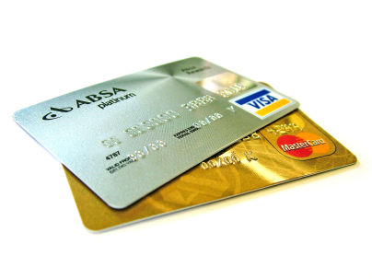


The phenomenon

Slide 8
Different lenses on the phenomenon
Credit use as ….
………..a psychological phenomenon
………..a process
Kamleitner, Hölzl & Kirchler 2012

Slide 9

Psychological phenomenon: reflection of the Situation
€

Slide 10
Psychological phenomenon: reflection of the person

Slide 11
Psychological phenomenon: a social practice

Slide 12
Psychological phenomenon: a decision aND cognitive process

Slide 13
Credit use as a process
before
Credit use
Kamleitner & Kirchler 2007
at
after

Slide 14

before credit use
before
Credit use
What
Whether Buy
How to
at
after

Slide 15
At credit take up
before
Credit use
Which credit?
at
after

Slide 16
After credit take up
before
Credit use
What now?
at
after

Slide 17
Bringing the perspectives together
2 at a time

Slide 18
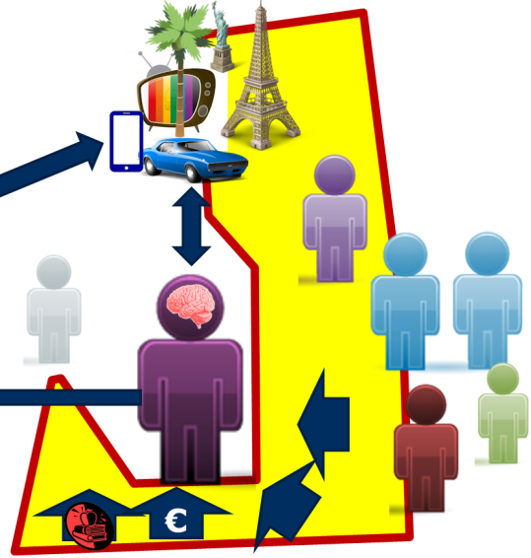
Research THEMES
Perspective: reflection of the situation
before
demographics
Credit availability
Life events
economic background
at
Search as DV
Access as DV
after
Repayment as a function of situation
Credit use as IV

Slide 19

Research THEMES
Perspective: reflection of the Person
before
Desire for now
Desire for good
Desire for credit
at
after
Repayment as a function of person
Credit use as IV: well being, attitude

Slide 20
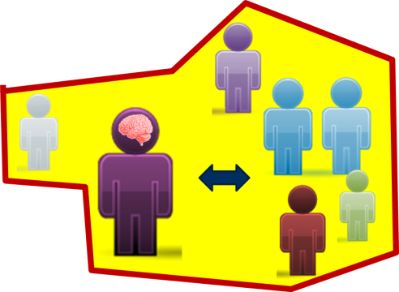
Research THEMES
Perspective: a social practice
before
society
Credit use as learned
Reference group stimulating desire
at
Borrower-lender
Access as DV
after
Repayment as a function social influences
Credit use as IV: social life

Slide 21
Credit use as a decision and cognitive process

Slide 22

Research THEMES
Perspective: a cognitive process
before
Intertemporal trade offs
Rational reasons
Mental accounting
at
installments
duration
Info search
risk
knowledge
Cost& interests
after
Credit use as DV: knowledge
Credit perception
Credit use as IV: thinking patterns

Slide 23
Research THEMES
Perspective: a cognitive process
before
Intertemporal trade offs
Rational reasons
Mental accounting
at
installments
duration
Info search
risk
knowledge
Cost& interests
after
Credit use as DV: knowledge
Credit perception
Credit use as IV: thinking patterns

Slide 24

Rational(ised) Reasons
              weighting pros and cons
  Self-control through commitment/
  protect savings (Erasmus & Mathunjwa, 2011)
  Take advantage of a temporary offer
  (Erasmus & Mathunjwa, 2011)
  Translate expectations into effective demand (Christie & Munro, 2003)

Slide 25

Intertemporal trade- offs
Present rewards loom larger & Future costs loom smaller
(e.g., Loewenstein & Thaler, 1989; Webley & Nyhus, 2008)
Particularly pronounced for small loans

Slide 26

mental accounting
mentally separating/ tracking income and expenditures (Thaler, 1980)
match source and purpose (Karlsson, Gärling & Selart, 1997)
Integrate anticipated (discounted) pleasure and pain over time – debt aversion except for long-lasting goods
(Prelec & Loewenstein, 1998)

Slide 27


Double-Mental Entry accounting
Coupling
the degree to which thoughts of payment arouse thoughts of consumption and vice versa (Prelec & Loewenstein, 1998)
α
payment
consumption
β
α (attenuation)
degree to which thoughts related to consumption evoke thoughts of payment
Benefit-to-cost association
β (buffering)
degree to which thoughts related to payment evoke thoughts of consumption
Cost-to-benefit association
Notes:
Herausheben – degree und direction

Slide 28
Research THEMES
Perspective: a cognitive process
before
Intertemporal trade offs
Rational reasons
Mental accounting
at
installments
duration
Info search
risk
knowledge
Cost& interests
after
Credit use as DV: knowledge
Credit perception
Credit use as IV: thinking patterns

Slide 29

Search for information
= relevant for reaching an economically sound decision
Low levels of information search (e.g., Peterson & Black, 1984)
Failure to search may be due to the perception of high search and switch costs (Canner & Lucket, 1992)
Searching does not necessarily translate into better decisions

Slide 30

Perception of credit components
Consumers care most about
immediate implications
  Monthly repayment amount (e.g., Herrmann & Wricke, 1998; Ranyard & Craig, 1995; Ranyard, Hinkley, Williamson, & McHugh, 2006)
  Loan duration
  Total costs
  Interest rates
Consumers care less about auxiliary features; e.g. rebates (e.g., Wonder, Wilhelm, & Fewings, 2008)

Slide 31

Credit components: select Peculiarities
First digit and “psychological odd” numbers - rates look smaller (Estelami, 2001; Wonder et al., 2008)
“Get it over with” (e.g., Amar et al 2011, Wonder et al., 2008)
  Unwillingness to commit very long
  Reduce comittment (e.g., Hoelzl, Kamleitner, & Kirchler, 2011)
little interest understanding but APR as price (e.g., Herrmann & Wricke, 1998, McHugh et al., 2011)
Duration underestimated (e.g.,Overton & MacFaden, 1998)
Risk denial for short, small loans (Ranyard, Hinckley & Williamson, 2001)

Slide 32

Financial knowledge
Knowledge can help but not necessarily a lot (e.g., Campbell, 2006 Levinger et al 2011)
more knowledgeable consumers receive better credit scores (Perry, 2008).

Slide 33
Research THEMES
Perspective: a cognitive process
before
Intertemporal trade offs
Rational reasons
Mental accounting
at
installments
duration
Info search
risk
knowledge
Cost& interests
after
Credit use as DV: knowledge
Credit perception
Credit use as IV: thinking patterns

Slide 34

Credit perception
Perception sometimes turns favorable:
  an alternative form of income (Norton, 1993)
  a delayed agreed payment (Katona, 1975)
Reference point shifted to being in debt (Beggan, 1994)
Loan burden: Habituation or recollection and forecasting bias?
(Hölzl, Pollai & Kamleitner, 2009)
Is loan perceived as connected to the good – coupling? (Kamleitner, Kirchler 2006; Kamleitner, Hölzl, Kirchler, 2010; Kamleitner et al. 2011)
  Depends on product
  Extent of indebtedness
  If yes, increased payment pain

Slide 35
(Financial) knowledge
people often badly informed about their credit plans (Emmons, 2004)
Most people know:
    how much their monthly installment is
    how large a part of their income that is (Katona, 1975)
Financial knowledge in general:
those who owe more, know more
Knowledge in terms of financial literacy can help (Bolton et al., 2011)

Slide 36
Credit use a rich field for further inquiry
Challenges and limitations

Slide 37


Current specific challenges across perspectives
  geographic gap
    Cultural differences?
  pre – past crisis gap
    Can research done before the financial crisis be compared with “past crisis” research?
  measurement
    What is consumer credit?
  Different types of credit –
  same theories?

Slide 38
The merrits of a cognitive perspective
The smallest common denominator
Equally important across the phases
Can deal with different decisions
and decision components

Slide 39
The main current limitation:
assumption that people pay attention to the credit part of a decision
…..some specific challenges/ opportunities

Slide 40
Social aspects as decision moderators?
Decison for n >1, advisor and advisee, the role of culture…
Gap &
opportunity

Slide 41
Gap &
opportunity
offering versus
process

Slide 42
Gap &
opportunity
Getting money versus good

Slide 43

Gap &
opportunity
Economical versus emotional optimization
Bias and Outcome

Slide 44

Gap & opportunity
Is credit special?
Credit as a feature of the offering
payment type alters product perception (Chatterjee, Rose 2012, Hahn et al. forthcoming; Kamleitner, Erki, 2013)

Slide 45
General challenges
New forms of payment
  Are we blinded by
  knowledge/ perspectives?
  Are we investigating the right people at the right time?
  Are we thinking about the phenomenon in the right way?
    Cause or consequence?
    A phenomenon in its own right?
    How many phenomena are we actually talking about?
    Are we keeping up with the trends
  Do we have the right methods?
Crowd financing
What if we got something wrong?
0% loans
Digital goods and new media

Slide 46

What‘s the message?
Keep an eye on
the evolution
of the
phenomenon
credit use
A cognitive perspective may help doing that without getting lost in the process

Slide 47
Thank you for your attention!
Univ. Prof. DDr. Bernadette Kamleitner
Department Marketing
Welthandelsplatz 1, 1020 Wien
E-Mail: bernadette.kamleitner@wu.ac.at
Tel.: +43 131336 4614

