Slide 1


THE RATIONAL ECOLOGICAL ELEMENTS AND STRUCTURE OF CONSUMER CREDIT DECISION-MAKING
Miguel Oliveira
BEHAVE/CES
Notes:
Good morning to you all. Let me direct a few words to our guest speakersfor this conference Professor Bernadette Kamleitner and Professor Ian Ramsay just to express the honour and satisfaction I feel to share this moments with them and of course with all the attendents whom I also salute and welcome. I am eager to hear from you about these matters Behave project is presenting here today at CES-Lisboa. (thank you for being here)

Slide 2
Itinerary
Focus on consumer credit take-up
(Kamleitner & Kirchler, 2007)
Ecological rationality and individual behavioral strategic flexibility:
  Sub-optimality & Dual-processing (construction of preferences and attitudes)
    Financial ecology instability and “stability” self-presentation
  Neoclassical Economics iron cast assumptions macro stability – equilibrium — micro stability — individual representative consumer preferences
Urban ecology of credit – presenting instability?
Intertemporal structure and momentary evaluation for credit take up
Topics about Psychological Evidence-Based Policy-Making — individuals and institutions:
  Unavoidable individual strategic flexibility (instability?) do not excuse avoidable institutional deception
  Individual processing and ecological instability are not necessarily negative. Institutional instability and stability deceptive proxies are.
  No need for complex solutions when simpler are at hand
  Nudges and beyond
Notes:
I will focus only on consumer credit take up moment which is obviously a small fraction of all the process o consumer credit use. I suggest the reading of two excellent reviews on the subject of the whole credit useKamleitner, B., & Kirchler, E. (2007). Consumer credit use: a process model and literature review. Revue Européenne De Psychologie Appliquée/European Review of Applied Psychology, 57(4), 267–283. doi:10.1016/j.erap.2006.09.003) and Kamleitner, B., Hoelzl, E., & Kirchler, E. (2012). Credit use: Psychological perspectives on a multifaceted phenomenon. International Journal of Psychology, 47(1), 1–27. doi:10.1080/00207594.2011.628674

Slide 3
Rational-ecological approach
The cognitive-ecological approach invites a reattribution of bounded rationality, suggesting that the origins of error and bias may lie more often than expected outside the human mind, in the information environment.
Fiedler & Wänke (2009, p. 705, italics added)

Slide 4
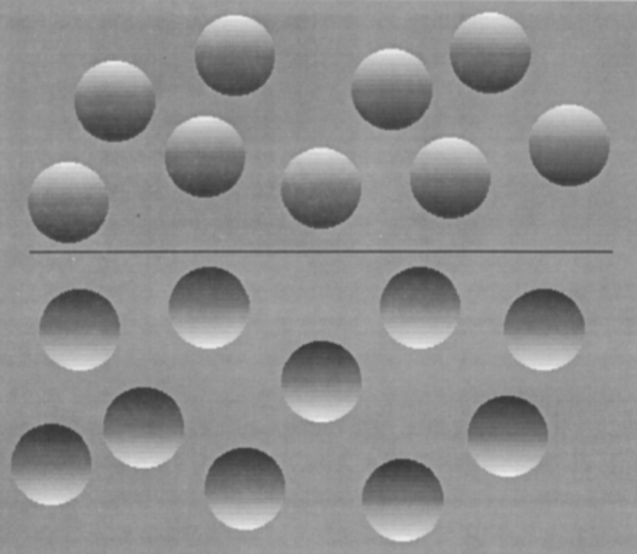
Ecological Rationality ≠ Irrationality
Visual (retinal) images are 2D
Inference from 2D to 3D based on cues in the environment – direction of light from source
Natural or learned (automatic, involuntary and unconscious) premises about the structure of the environment:
Either the light comes from above or from below
There is only one source of light
(Kleffner & Ramachandran, 1992)
Rule:
shade on the upper side – convex
shade on the bottom side – concave
Notes:
LETS SEE AN EXAMPLE OF ECOLOGICAL RATIONALITY IN THE LABORATORY AND THINK ABOUT IT IN THE WILDPAY ATTENTION TO THE WHITE SQUARE AT THE UUPER RIGHT CONER OF THE PICTURE.

Slide 5
Ecological Rationality ≠ Irrationality
Rule applied on an actual environment — rational ecological decision – one that explores the correct match of mind works and environment structure.
Despite being a non-optimal rule it will work adaptively to warrant a good decision
Otherwise it will become an optical illusion as you forcefully have experienced a while ago.
Kruglanski, A. W., & Gigerenzer, G. (2011). Intuitive and deliberate judgments are based on common principles. Psychological Review, 118(1), 97–109. doi:10.1037/a0020762
Notes:
WE PERCEIVE THE ECOLOGY BY SEARCHING FOR REGULARITIES OR HAVING ALREADY BUILT-IN ASSMUPTIONS (OPTICAL ILLSUION WE JUST SAW A MOMENT AGO). DEPENDING ON HOW SUCH REGULARITIES ARE ECOLOGICALLY VALID (PREDICT WITH SOME ACCURACY) WE FALL OR ESCAPE OPTICAL ILLSUSIONS OR SIMILAR TRAPS
Só no fim
GIVEN THESE PRELIMINAR ON HOW THE SAME FUNCTIONING INFERENTIAL PROCESS WORK IN ARTIFICAL AND NATURAL ECOLOGIES LETS LOOK AT PSYCHOLOGY AND ECONOMICS PREMISES ABOUT HUMAN PROCESSES SUPPORTING BEHAVIOR

Slide 6



Fundamental Attribution Error
(Ross, 1977)
&
The Individual Representative Consumer
Judgments of rational quality of others’ attitudes, intentions and actions:
drawn on the sole basis of internal states of the individual even when plausible and provable rivaling external forces are in place to explain her behavior (Tetlock, 1985) .
Psychologists often commit this error — gross disregard of environment causality – focus on internal states (emotion, cognitions, expectations, etc.) or traits (personality) (Gigerenzer, Fiedler & Olsson, 2012)
Psychology view
Blank context
Emotions
Motives
Cognition
Expectations
Economists push the case a little further:
- Posit an individual representative consumer (Kirman, 1992) with
stable and complete preferences revealed through an imaginary questionnaire (Samuelson, 1948; Edwards, 1954/2009)
irrespective the context and the usual capacity limitations of mortals (Oliveira, 2005).
A uniquely self-interested subject acting as if he is maximizing utility and/or minimizing disutility (see Berg & Gigerenzer, 2010 for behavioral economics similar grounds)
Economics view
For all contexts
Emotions
Motives
Cognition
Expectations

Slide 7
Homo economicus
I am predicting that Homo Economicus will evolve into Homo Sapiens
(Thaler, 2000, p. 140)
Notes:
I am predicting that Homo Economicus will evolve into Homo Sapiens
However, there is no dearth of evidence that human decision-makers are not fundamentally utility Maximizers. This is a story that goes back at least some 60 years ago (Oliveira, 2005; Lichtenstein & Slovic, 2006)
Sometimes is even difficult to find one exemplar of Homo economicus in the real world. Heinrich et al. (2001) did not found one in 15 remote small-scale societies (using the ultimatum game).
ULTIMATUM GAME - two players interact to decide how to divide a sum of money that is given to them. The first player proposes how to divide the sum between the two players, and the second player can either accept or reject this proposal. If the second player rejects, neither player receives anything. If the second player accepts, the money is split according to the proposal. The game is played only once so that reciprocation is not an issue.

Slide 8
Decision-Making Rationalities
DEMONIC
BOUNDED
ECOLOGICAL
Omniscience
Full computational power
Perfect memory
Infinite Time
Limited Information
Limited Processing
Capacity (memory and reasoning)
Time Pressure
Matching Environment Structure (physical, social, psychological, financial) operations and heuristics navigating and exploring the ecology upon mental capacities
Optimizing
Satisficing
Fast and Frugal
Are we these many rational decision-makers?
I believe that we partially can, and credit decision-making is a good terrain to show it.
Notes:
DEPENDING ON THE RULE WE USE FOR THE ENVIRONMENT IN WHICH WE USE IT — GOOD MATCH (ALWAYS SUB-OPTIMAL) BEHAVIOR WILL LOOK RATIONAL/ NO MATCH – BEHAVIOR LOOKS IRRATIONAL (REMEMBER OPTICAL ILLUSIONS OR BIASES SUCH AS AVAILABILTY HEURISTICS)

Slide 9
    Financial ecology instability and “stability” self-presentation
Neoclassical Economics iron cast assumptions – exeunt reality
    stable preferences — individual representative consumer
“the failure of the endeavor to derive market rationality from individual rationality … is a waste of time. … as Kirman put it, ‘If we are to progress further we may be well forced to theories in terms of groups who have collectively coherent behavior’.” (Keen, 2011, p. 74; see Kirman, 1992; bold added)
Notes:
IT SEEMS LOOKING FOR EFFECTS OF SMALL AGGREGATE DECISION-MAKING (SOCIAL CLASS, PROFESSIONAL BELONGING) AS MARKETING PROFESSIONAL DO (SEGMENTATION) FINDING REGULARITIES IN GROUP BEHAVIOR (EX. HERDING – MICHELLE BADDELEY, 2012) will pay off more than current focus on a holow robotic individual decision-maker

Slide 10
    Financial ecology instability and “stability” self-presentation
Neoclassical Economics iron cast assumptions – exeunt reality
    stability – equilibrium
      convex preferences, perfect competition, demand independence (Arrow-Debreu) - such conditions do not exist (Sonnenschein-Mantel-Debreu Theorem, SMD):
  “…a deeply negative result. … means that assumptions guaranteeing good behavior at the microeconomic level do not carry over to the aggregate level or to qualitative features of the equilibrium.” (Rizvi, 2006, p. 230)
Notes:
I’D RATHER NOT GO INTO THESE PREMISES LONGER THAN I DID ALREADY. AFTER ALL I AM NOT AN ECONOMIST. HOWEVER THINK IF PHYSICS OR CHEMESTRY USES SUCH STRINGENT ASSUMPTIONS NOT MATCHING REALITY TO LEGITMATE THEIR ENDEAVOR.

Slide 11
Individual behavioral strategic flexibility
We should we then ask first:
How do people really deal with the “pure” information pieces needed to decide credit take up without motivation and emotion (no concerns about and interference from the nature of the purchase object) ?
Experimental study (Jesus & Oliveira, 2011) — confronted participants with a task designed as full factorial combination of three factors:
  Annual Percentage Rate (6%, 12% and 18%)
  Loan Repayment Period (12, 36, and 60 months)
  Installment (35€, 75€, and 115€ per month), on the three-, two-, and one-way designs embodied in a set of vignettes
Participants: 17 participants all graduate and employed (9 female); ages between 24 and 57 years old (M=34.18, DP=8.58). Mostly WEIRD people = White, Educated, Intelligent, Rich, Democratic (Henrich, Heine & Norenzayan, 2010)
Notes:
HOWEVER HOW ABOUT TRYING TO EXPLORE “PURE” CONDITIONS OF HUMAN BEHAVIOR FUNCTIONING BY DESIGNING ASN EXPERMENT IN WHICH THE SOLE DRY AND COLD INFORMERS USUALLY PRESENTED IN DREDIT TAKE UP PROPOSALS? How do people really deal with the needed “pure” information pieces to decide credit take up without motivation and emotion (no concerns about and interference from the nature of the purchase object) ?

Slide 12
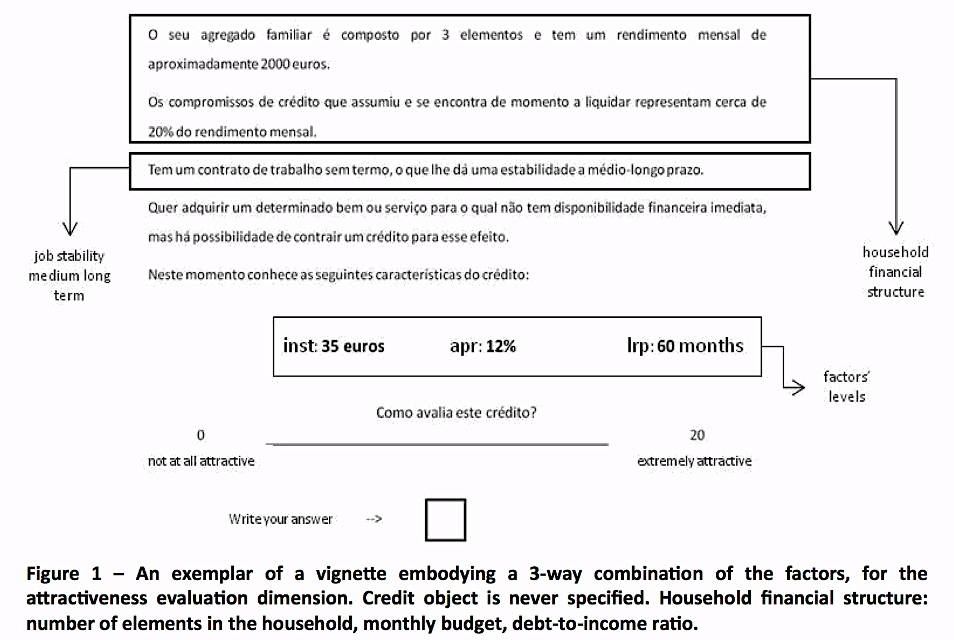
Individual behavioral strategic flexibility
How do people deal with the “pure” information pieces needed to decide for credit uptake?
An exemplar of a vignette embodying a 3-way combination of the factors for the attractiveness evaluation dimension. Credit object is never specified.
Notes:
Design: A full factorial within-subjects design was implemented along attractiveness, willingness and riskiness evaluation dimensions, performing a 3 (APR) x 3 (LRP) x 3 (INST) design. To-way and one-way sub-designs were added to the main design. Each condition was presented randomly and twice, on a total of 126 events per dimension.
Procedure: Participants were instructed to imagine themselves in the situation depicted by the vignettes and asked to rate each credit proposal according to its attractiveness, its riskiness, and her/his willingness to accept, using a 0-20 scale. The numerical end anchors for attractiveness were accompanied by “Not at all attractive”, and “Extremely attractive”; for riskiness by “Not at all risky” and “Extremely risky”; and finally for willingness by “Not at all willing” and “Extremely willing”. Evaluation dimensions were counterbalanced within-subjects with a little rest break between them. Participants were also fully instructed on the importance of paying attention to the evaluation dimension they were asked to use. Participants had a set of six training trials before the first scheduled evaluation dimension.

Slide 13
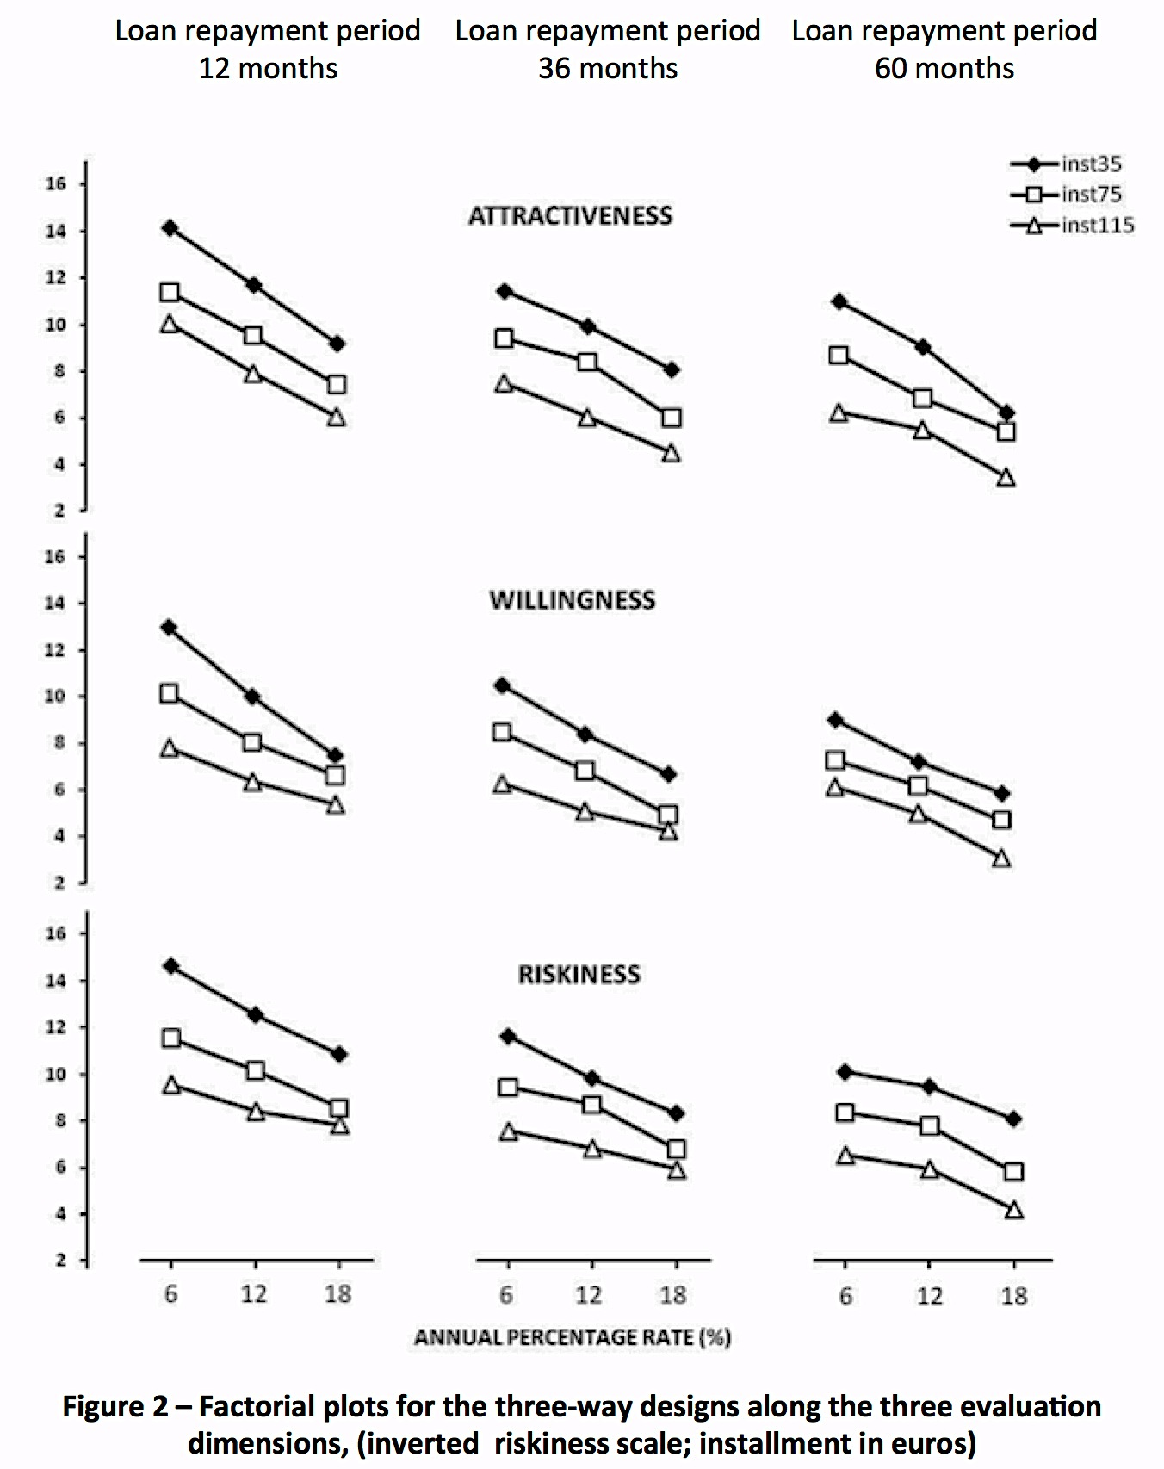
Individual behavioral strategic flexibility
How do people deal with the “pure” information pieces needed to decide for credit uptake?
RESULTS
When forced to use all the information given, no time limits to compute, and no purchase object specification, the aggregated* rating patterns look very RATIONAL across evaluation dimensions
stable and aligned ratings of factors’ levels combinations from smaller to larger:
APR (abscissas),
LRP (left to right columns), and
INST (parameter curves) levels
However, are these the sole elements in the usual ecology of credit take up? Would rating stability remain in actual ecologies of credit take up?
Reversed scale
Notes:
*patterns of individual evaluation are very similar between subjects for all dimensions
However, are these the sole elements in the usual ecology of credit take up? Would rating stability remain in actual ecologies of credit take up?

Slide 14
Individual behavioral strategic flexibility
How do people deal with the “pure” information pieces needed to decide for credit uptake?
RESULTS
When forced to use all the information given, no time limits to compute, and no purchase object specification, the aggregated* rating patterns look very RATIONAL across evaluation dimensions
stable and aligned ratings of factors’ levels combinations from smaller to larger:
APR (abscissas),
LRP (left to right columns), and
INST (parameter curves) levels
However, are these the sole elements in the usual ecology of credit take up? Would rating stability remain in actual ecologies of credit take up?
Reversed scale
Notes:
*patterns of individual evaluation are very similar between subjects for all dimensions
However, are these the sole elements in the usual ecology of credit take up? Would rating stability remain in actual ecologies of credit take up?

Slide 15
Rational Ecological Elements Consumer Credit Decision-Making
Decision-making Strategic flexibility
Why should ecology elements matter?
  They tap into specific cognitive/affective processing features (dual-processing) that explain strategic flexibility leading either to bias and traps or to successful heuristic processing (Evans, 2008; Slovic et al. 2002; Kruglanski & Gigerenzer, 2011)

Slide 16
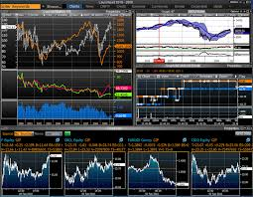

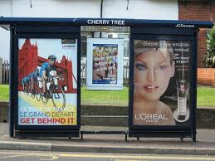

Dual-processing
The dance of affect and reason
(Slovic et al., 2005)
Confronted with features of the ecology, processing of information will mobilize different functioning parts under distinct regimes
Intuitive vs. deliberate judgments
Intuitive – associative, quick, unconscious, effortless, heuristic and error-prone
Deliberative – rule based, slow, conscious, effortful, analytic, and rational
(+)
(=)
(≥)
(♡)
(4)
(☁︎)
(?)
Emotions
Motives
Cognition
Expectations
Notes:
YOU HAVE DIFFERENT STIMULI ELICITING A MYRAD OF POSSIBLE RESPONSES THAT INDIVIDUAL SUBJECT WILL NOT CONTROL because he is not aware or capable to allocate attention on the huge number of the ongoing processes
Automatic processing is activation of a learned sequence of elements in long-term memory that is initiated by appropriate inputs and then proceeds automatically—without subject control, without stressing the capacity limitations of the system, and without necessarily demanding attention
Controlled processing is a temporary activation of a sequence of elements that can be set up quickly and easily but requires attention, is capacity-limited (usually serial in nature), and is controlled by the subject

Slide 17
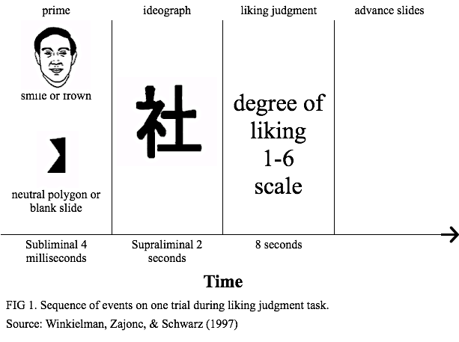
Mere Exposure & other non-deliberate processing examples and their uses
Ways in which cues and information in the ecology specifically tap into the experiential system leading to reliance on its outputs
Affectively
neutral
good or bad?
Smiling face : more liking
Frown face: less liking
or
Polygons: in between
Notes:
ANY VISUAL PRESENTATION OF A STIMULUS UNDER 100 MILLISECONDS THOUGH PROCESSABLE PRECLUDES THE SUBJECT TO BE AWARE OF IT (A PRIME IS SUCH A PRESENTATIN DESTINED TO FAVOR OR DISFAVOR AN EVALUATION OF SUBSEQUENT PERCEPT OR TO CUE PERCEPTION TOWARDS ANY TARGET OR PURPOSE IT IS DEEMED TO BE CAPBLE OF
IN THIS CASE MERE EXPOSURE WITHOUT REPETITION AND OR REINFORCEMENT (LEARNING) IS ENOUGH TO DIRECT CONSISTENTLY EVALUATIONS (LIKE, DISLIKE)

Slide 18
Mere Exposure & other non-deliberate processing examples and their uses
Recognition memory
not a deliberate process, although its outcome might be used for deliberate judgments.
reliance on this outcome is a non deliberate judgment (Kruglanski & Gigerenzer, 2011)
Fluency
feeling of easiness with which something comes to mind or is perceived (Schwartz et al. 2009).
On the other hand, deliberate use of consciously controlled analytical rules can become automatized (e.g. driving, computing numbers) although allowing for control reactivation.
Notes:
AN EXAMPLE OF FLUENCY IS: IF IT IS DIFICULT TO PRONOUNCE IT MUST BE RISKY - THE NAME OF A CHEMICAL ELEMENT PRESENT IN A REMEDY PRESCRIBED BY A DOCTOR (SONG & SCHWARZ , 2009)

Slide 19
Habit and Routine Formation
Experience, Social development, Acculturation contribute to rule acquisition and its use modulation resulting in a flexible set of tools to deal with the ecology demands (toolbox)
Variety of consequences differently evaluable from both observation of subjective overt behavior and subjective conscious self-control points of view (Vohs & Baumeister, 2011; Wegner, 1997)
Therefore, also from an individual freedom and social accountability point of view (Baumeister et al., 2008)
Notes:
Baumeister, Roy; Sparks, Erin; Stillman, Tyler; Vohs, Kathleen D. (2008), “Free will in consumer behavior: Self-control, ego depletion, and choice”, Journal of Consumer Psychology, 18(1), 4–13.

Slide 20
Rational Ecological Elements Consumer Credit Decision-Making
Decision-making Strategic flexibility
Why should specific elements of the credit ecology matter? (see Estelami, 2001)
  They impinge on the strategic flexibility in the present time evaluations about future time
    Flexibility — good whenever it warrants momentary and long run well-being; it is bad if it hinders well-being forecasting in the short and the long run
      e.g. akrasia - deciding against one’s best interests (Ainslie, 2001), or
      against the common good – tragedy of the commons (Harding, 1968)
Notes:
Annual Percentage Rate; repayment period, final total amount of credit, installments, information about risk defusing (insurance) and other taxes, etc.
Estelami found that Rates used by consumer to evaluate credit arrangements vary from those used by financial markets as a negative function of credit amount and payment time. Numeric presentation (odd/even) and dis-aggregation of credit obligations influence discount rates. dis-aggregation into Smaller components of credit amount favor smaller discount rates

Slide 21
Rational Ecological Decision-Maker
There is no one-size-fits-all strategy for an all seasons ecology
“… no heuristic or optimizing strategy is the best in all worlds. Rather we must ask, in what environments does a given heuristic perform better than a complex strategy, and when is the opposite true?”
(Todd & Gigerenzer, 2012, p. 5)

Slide 22
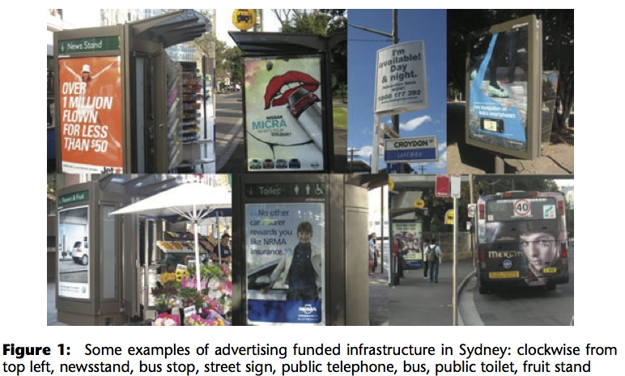
Rational Ecological Elements Consumer Credit Decision-Making
Urban ecology of credit take up
Tokens or proxies (right) — cues to the consumer who is also a carrier of advertising digital messages (e.g. smartphones).
Time: time pressure, deadlines, and duration — elements also belonging to the architecture of credit
They all become entangled with physical-perceptual settings we found in our cities as we travel, stop by to observe and search for something, or simply take a rest. They foster recognition memory, fluency, and focalism (Gilbert e Wilson, 2011).
source: Iveson, K. (2011)
A deliberate choice of marketers and publicists and their contractors to arrange purchasing environment (Nagle, Hogan & Zale, 2011) merely exposing people (Zajonc, 2001) to the “possibility of…” (e.g. having a drink, buying a house, going to the movies) thereby manipulating whishes, time perception, and exploiting forecasting frailties.
Amount of money spent worldwide in advertising in the year of 2012 hit $490 billion (≈ nominal 2012 Poland’s GDP), a 3.6% increase over spending in 2011
http://www.groupm.com/pressandnews/details/920
Notes:
NAGLE, HOGAN & ZALE 2011 . SUGGEST THAT THE EFFECT OF TACTICS OF ODD NUMERIC PRESENTATION MAY HAVE HIGHR EFFECTS WHERE INFORMATION OVERLOAD AND STIMULUS COMPLEXITY IS PRONOUNCED.

Slide 23
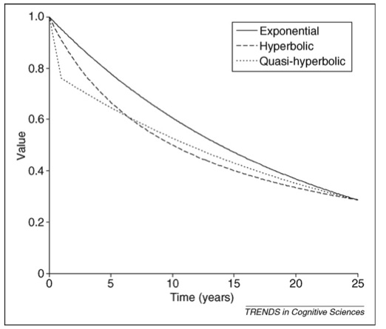
Rational Ecological Elements Consumer Credit Decision-Making
Intertemporal Choice
“used to describe any decision that requires tradeoffs among outcomes that will have their effects at different times” (Read, 2004, p. 424)
When confronted with choices between smaller sooner (SS) and larger later (LL) rewards people tend to prefer SS to LL – this does not fit the rational model of time exponential discounting of utility (Samuelson, 1937).
People also seem to discount more on gains than on losses preferring to incur in loss immediately than postpone it (e.g. traffic ticket) – sign effect
People usually prefer increasing series of value (utility) over time would you prefer visiting first:
  Your old tattler auntie and after have dinner with friends or the other way around?
1
“... individuals discount the value of delayed consumption more heavily when delaying an immediate consumption (e.g., from today to tomorrow)
than when delaying the same consumption over an equal delay starting at a later date (e.g., from 30 days from today to 31 days from today).” (Kim & Zauberman, 2009, p.91).
Notes:
NOW WE Turn to An essential dimension in behavior understanding is time and duration perception and how our evaluations and expectations are always contextualized in present time despite being about future time
Hyperbolic is justified not because of extreme discounting per se rather because of the hyperbola curve that can be plottedfrom data.

Slide 24
Rational Ecological Elements Consumer Credit Decision-Making
The intertemporal structure of consumer credit
Lack of sufficient available money to buy a needed or desired good or service determines a few consuming alternatives: borrowing or saving
forces purchase delay avoids paying above object’s price value
consumption delay
BORROWING
intertemporal relationships established about
consumption related uncertainties leading to
  Distorted forecasting of:
    pleasures and pains of consumption
    future self desires
(Hogarth, 2010; Kahneman & Snell, 1992; Wilson & Gilbert, 2005).
avoids declining purchase even when no money is available
periodic payments in fixed installments + additional interest value on object ́s price value
SAVING
people indulge into paying more for no waiting

Slide 25
Rational Ecological Elements Consumer Credit Decision-Making
The intertemporal structure of consumer credit
  Immediacy/certainty and delay/uncertainty (risk) seem to be interchangeable (Keren & Roelosfma, 1985)
  Pseudo-immediacy effects (Li et al., 2010) similar to pseudo-certainty effects (Tversky & Kahneman, 1986) -overestimation of small probabilities by perceived immediacy of the reward
Frame
Consumption
as
now = gain
deferring = loss
  More likely to lead to impulsive or impatient behavior

Slide 26
Credit Take Up Decision-Making
Perceived Effort of Repayment
In credit take up context - decoupling of pleasures and pain of consumption occurs (Loewenstein & Prelec, 1998) because:
  present time reward allows for immediate good consumption
  future time punishment (payments) is deferred over time
are naturally established
Questions:
Is trade-off between rewards and punishments biased by ill-representation of one of its parts — negative consequences or punishments (payment), once they also tend to be discounted over time?
Payment effort — negative downside psychological representation:
is effort of payment discounted over time? (Botvinick, 2009; Kivetz, 2003) as evaluated at credit take up moment

Slide 27
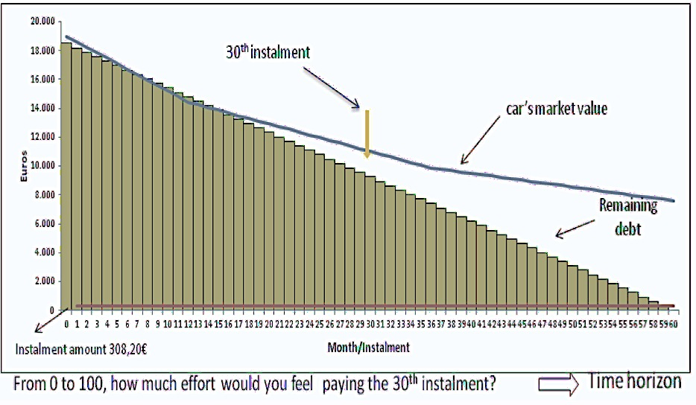
Credit Take Up Decision-Making
Perceived Effort of Repayment
Experiment:
Credit situation wherein participants imagine they have decided to buy some good hedonic/utilitarian (a car, surgery, or non-specified);
Task: rate on a numerical scale (from 0 “no effort at all” to 100 “extreme effort”) how much effort to pay installments (same value) as presented in the specific time horizons: “today”, “10”, “20”, “30”, “40”, “50”, and “60” months.
Two Groups: One was shown information how the good or service they had purchased would decrease in value across repayment period in tandem with decreasing debt amount — hidden-zero presentation (see vignette) the other was shown no information.

Slide 28
Credit Take Up Decision-Making
Perceived Effort of Repayment
Looking for the hidden-zero effect (Magen et al., 2008) :
  “By simply mentioning the ‘obvious’ downsides of alternatives, one can help decision makers choose in a more informed and balanced manner, thereby helping them place more weight on the achievement of their long-term goals, rather than on immediate gratification.” (p. 649)
Hedonic vs.Utilitarian consumption goods (Dahr & Wertenbroch, 2000)
  Hedonic objects— higher share of affective gratification attributes/Utilitarian— higher share of convenience and practical attributes (Batra & Ahtola, 1991)
At credit take up situations — not taking up credit equated with loosing a good already felt as possessed or owned. Hedonic objects would therefore be more easily targeted than utilitarian ones in similar situations.

Slide 29
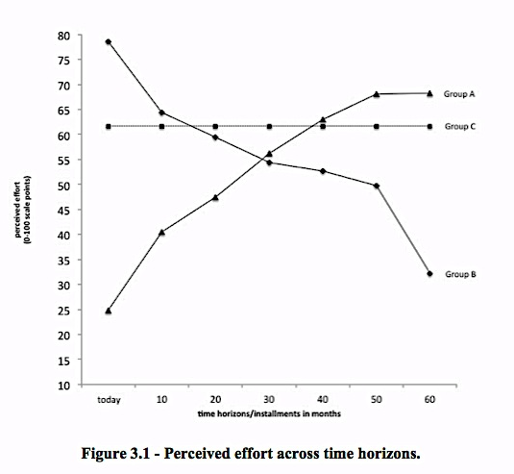
Rational Ecological Elements Consumer Credit Decision-Making
No effects of hidden zero presentation nor of object hedonic/utilitarian quality were found – new data collected in new experiment correcting some design limitations will show if replication occurs; other aspects to be studied — partition in time horizons (no partition, 3 horizons and 7)
However, participants have split along three categories of effort perception rating
We speculate on how people perceive information elements of credit proposal:
  Group A (increase perceived effort over time): effect of present bias focused on object possession (endowment), expecting a decline in consumption satisfaction as installments appear at more distant time horizons?
  Group B (perceived effort discount over time): an effect of present bias focused on initial debt (global amount) decreasing over time ?(note: time horizons are randomly presented by subject)
  Group C (no change in effort perception): effect of focusing attention to the same nominal value of installments across time horizons
Despite no effects were found for the hidden-zero presentation factor, we still follow Magen et al (2003) in that providing information about the downside of choices will make people more conscious about consequences and more apt to choose in their own good interest.
These non corroborating results of our expectations, do not erase strategic flexibility that do occurs irrespective demographics, experimental groups, objects and hidden-zero presentation. Prediction of behavior at credit take moment deserves further inquiry in order to fuel insights and measures to be implemented in the domains of regulation and financial counseling
N= 68
N= 38
N= 41
(Jesus & Oliveira, 2013)

Slide 30
Topics about Psychological Evidence-Based Policy-Making
  Unavoidable individual strategic flexibility (instability?) do not excuse avoidable institutional deception
  Individual processing and ecological instability are not necessarily negative. Institutional instability and deceptive stability proxies are.
  No need for complex solutions when simpler are at hand
  Nudges and beyond (structuring and describing) – Johnson et al. (2012)

Slide 31
Thank you very much for your attention

